Slide 1
Remarkability Superiority Test
Exploratory Analysis for textual data

Slide 2
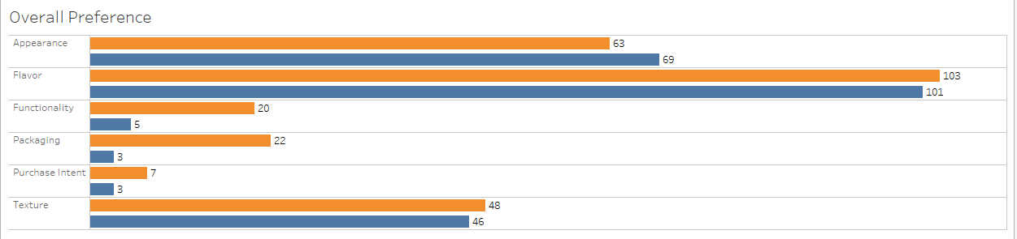
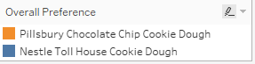
Overall Preference - Open Ends
Use sheet open_ends_topic_categorization
Functionality and packaging for Pillsbury dough are clearly preferred more by consumers when compared to nestle toll house cookie dough

Slide 3
Functionality : From Open End Responses
Use Sheet :
functionality_pref
People who preferred Pillsbury over nestle for functionality, 60% said that Pillsbury cookie dough was :
easier to break apart
easier to get it out of package (overlaps with packaging)
easier to cook
Notes:
Methodology :
Done using word frequencies for this subset of responses
Used collocation to identify frequent occurrences of words

Slide 4
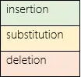
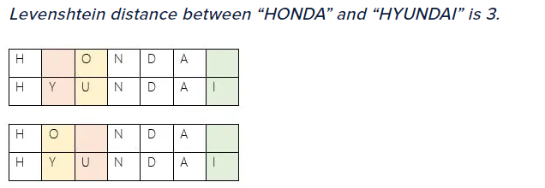
String Similarity : Minimum Edit Distance (Levenshtein distance)
String similarities are calculated between two strings using minimum edit distance.
Minimum number of operations required to make two strings same as each other, operations being :
Notes:
Example taken from :
https://www.cuelogic.com/blog/the-levenshtein-algorithm
Deep dive :
https://blog.paperspace.com/measuring-text-similarity-using-levenshtein-distance/

Slide 5
Topic Mapping considerations :
One response has been mapped to multiple categories.
This can be changed to map at most 1 or 2 based on scores (if it makes sense to do this).
In the analysis sheet, every word that has been found or mapped with the response has a score associated with it.
The score represents how close the match was.
Complex rules can be built to include matches that are less close than the first match, along with thresholds. (low threshold == word that is quite dissimilar)
We can create hierarchies within top level categories

Slide 6
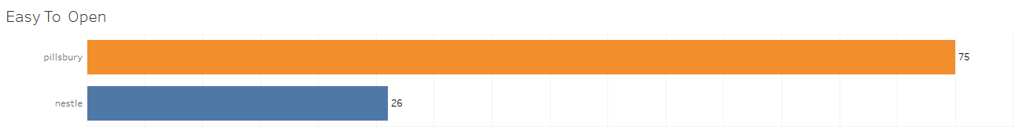
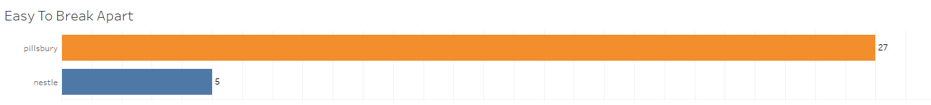
Packaging Open ends
Use Sheet :
pp_easy_to_open
pp_break_apart
Packaging and functionality superiority – Not only is the Pillsbury cookie dough easier to open, but they are easier to break apart as well
Notes:
Methodology : After text pre-processing,
Used most frequent words to determine trend.
Used collocation (most frequently words that appear together) to get the count

Slide 7
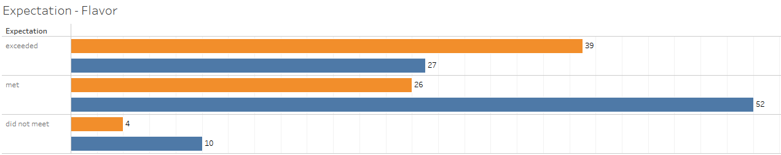
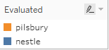
Meets Expectation : Highlights : Flavor
Use Sheet:
me_category
Overall, Pillsbury cookie dough exceeds consumer expectations for flavor and has a relatively lower number of responses where expectations were not met.
However, nestle toll house looks like it has the right amount of flavor given that it meets expectation of twice as many consumers as Pillsbury cookie dough
Notes:
How :
Filtered for respective brand
Topic categorization applied (responses categorised into appearance, flavor, texture, Packaging, Functionality)
Most frequently tagged topic was chosen : Flavor
On the basis of the evaluated sample, these numbers were computed.
Note : These numbers are subject to validation of topics that have been assigned to the responses.

Slide 8
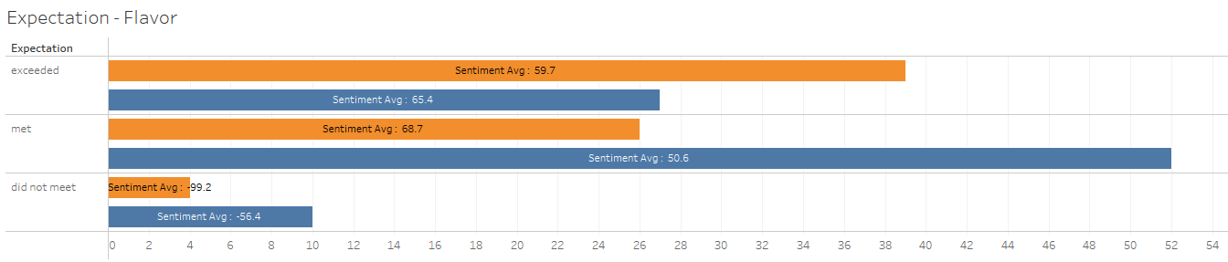
Meets Expectation : Highlights : Flavor
Use Sheet:
me_category
Same as previous, sentiment added. For responses where consumers expectations either met or exceeded, the overall sentiment for Pillsbury (64.2) is higher than nestle toll house (58)
Link to try distil BERT - https://huggingface.co/distilbert-base-uncased-finetuned-sst-2-English
Notes:
How :
Filtered for respective brand
Topic categorization applied (responses categorised into appearance, flavor, texture, Packaging, Functionality)
Most frequently tagged topic was chosen : Flavor
On the basis of the evaluated sample, these numbers were computed.
Additionally, sentiment was calculated using a pre-trained model (distil bert) - https://huggingface.co/distilbert-base-uncased-finetuned-sst-2-English
Sentiment score still looks purely indicative, validation, along with correct required.
Note : These numbers are subject to validation of topics that have been assigned to the responses.

Slide 9
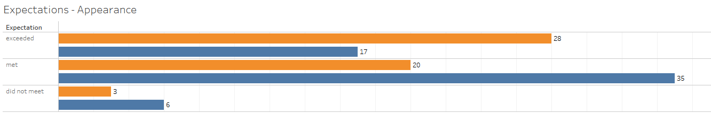
Meets Expectation : Highlights : Appearance
Use Sheet:
me_category_appearance
From an appearance perspective, Pillsbury cookie dough exceeds expectations of a higher number of respondents and has a low count for expectations not met as well
Notes:
How :
Filtered for respective brand
Topic categorization applied (responses categorised into appearance, flavor, texture, Packaging, Functionality)
Second most frequently tagged topic was chosen : Appearance
On the basis of the evaluated sample, these numbers were computed.
Additionally, sentiment was calculated using a pre-trained model (distil bert) - https://huggingface.co/distilbert-base-uncased-finetuned-sst-2-English
Sentiment score still looks purely indicative, validation, along with correct required.
Note : These numbers are subject to validation of topics that have been assigned to the responses.

Slide 10
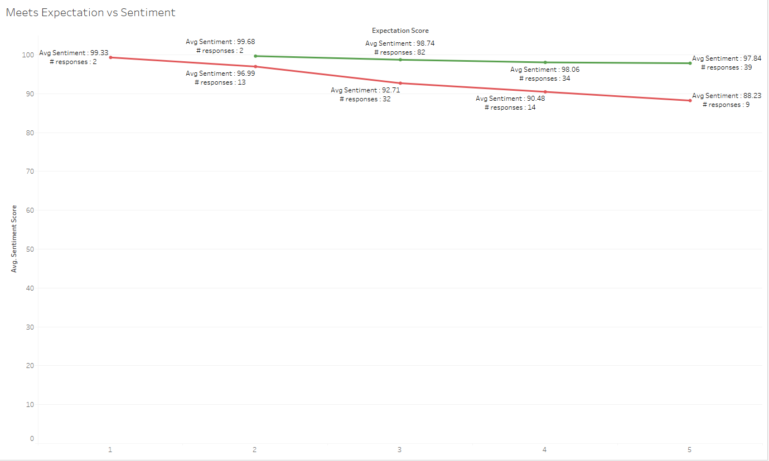
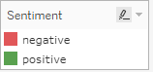
Meets Expectation vs Sentiment

Slide 11
Observations/Opinions
Topic categorization
Done using Cookie Corpus file.
Having distinct words being used for different categories produces clearer categories. (less overlaps)
Example - When “dough boy” was used as a term for packaging, “dough boy” was an accurate match for packaging, appearance and flavor too. (since “dough” was )
Needs to be validated. Result of validation and correct categorization can be used for next steps
Attempted unsupervised topic modelling to discover common trends
Observation – Nestle felt more homemade – but only 4 responses from open ends say this. (use sheet oe_topic_discovery)
With the current topic categorization approach, quality of corpus words will matter.
Overall, keyword based topic categorization seems relevant right now. (easier to identify trends)
Sentiment Analysis –
It’s indicative. Basic validation shows incorrect categorization in some instances – especially for sentences that are tagged as negative.
Best way would be to measure accuracy by correcting incorrectly classified sentiments and compare.
This activity will also mean labelling data and can contribute for future sentiment classification
May be helpful to not use sentiments for certain responses (very short and undescriptive)

Slide 12
To Try:
Use synonyms from the corpus to build a bigger and relevant corpus
Experiment with different pre-trained sentiment analysis models to compare results.

